Slide 1


Slide 2
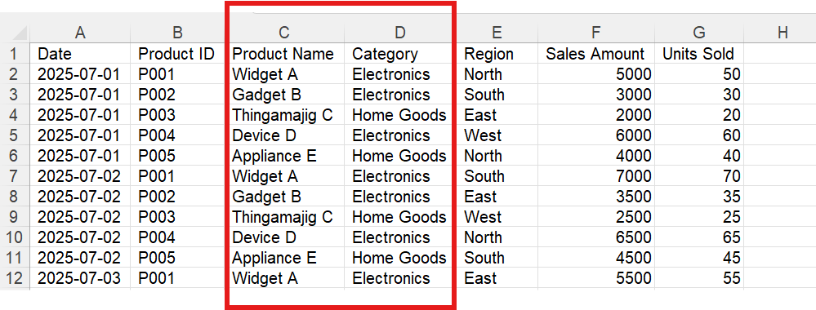
Single-Table Data Design
A single flat data table consolidates all information without separation into fact and dimension tables.
This structure can lead to redundancy and inefficiencies, impacting performance and scalability.
Exploring structured approaches can mitigate these challenges and enhance data analysis.

Slide 3
Issues with Single-Table Data Design
Data Redundancy: Repeated information across rows can lead to increased storage requirements and inefficient use of space.
Maintenance Complexity: Updating information, such as changing a product name or category, requires changes to multiple rows, increasing the risk of errors and inconsistencies.
Performance Issues: Queries can be less efficient because the database engine has to process more data than necessary, especially if the table grows large.
Scalability Limitations: Adding new dimensions or facts can be challenging without altering the entire table structure, limiting scalability and adaptability.
Lack of Flexibility: Analyzing data from different perspectives (e.g., by time, product, or location) can be cumbersome without a structured approach.
Difficulty in Data Integrity: Ensuring data integrity becomes more complex as redundant data increases the chances of inconsistencies.
Complex Query Logic: Writing queries to extract meaningful insights can be more complex, requiring additional logic to handle the flat structure.

Slide 4
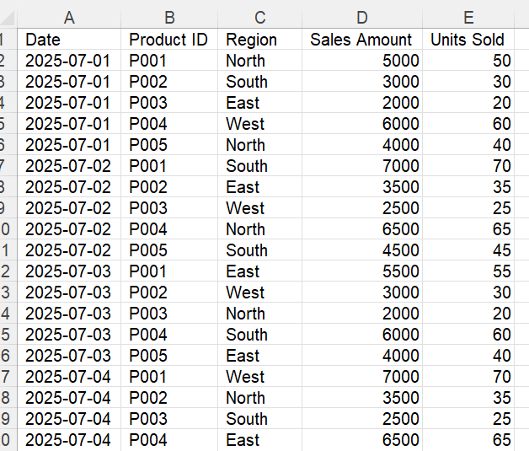
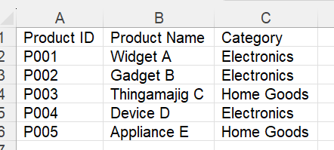
Fact And Dimensional Tables
Fact Table
Dimensional Table
Fact Tables: Fact tables store quantitative data for analysis, such as sales figures or quantities, and contain foreign keys linking to dimension tables.
Dimension Tables: Dimension tables provide descriptive context to the facts, such as product names or dates, enabling flexible data analysis from various perspectives.

Slide 5
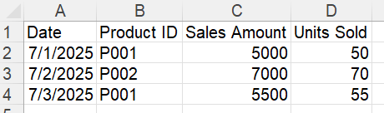
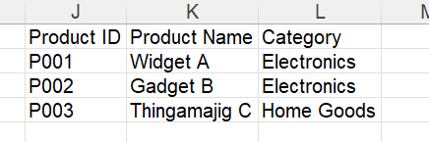
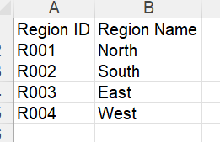
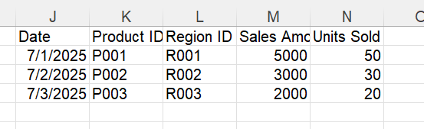
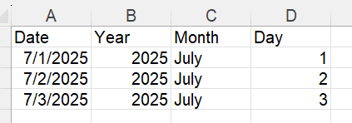
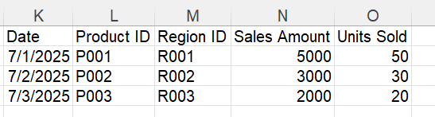
Fact And Dimensional Tables
A)
B)
C)

Slide 6
Understanding Table Relationships in Power BI
1. One-to-Many (1:*):
Description: This is the most common relationship type. It means that a single record in one table can relate to multiple records in another table. The "one" side is typically a dimension table, while the "many" side is a fact table.
When to Use: Use a one-to-many relationship when you have a dimension table containing unique values (e.g., product IDs) and a fact table with multiple occurrences of those values (e.g., sales transactions).
2. Many-to-One (*:1):
Description: This is essentially the inverse of the one-to-many relationship. It occurs when multiple records in one table relate to a single record in another table.
When to Use: Power BI automatically handles many-to-one relationships as one-to-many, so you typically don't need to explicitly define them. However, conceptually, you use this when a fact table relates back to a dimension table.
3. Many-to-Many (:):
Description: This relationship type allows multiple records in one table to relate to multiple records in another table. It requires a bridging table or a direct many-to-many relationship setup.
When to Use: Use many-to-many relationships when you have complex scenarios where both tables contain non-unique values that need to relate to each other, such as shared attributes across multiple entities (e.g., students and courses).
4. One-to-One (1:1):
Description: This relationship type means that each record in one table corresponds to exactly one record in another table.
When to Use: Use one-to-one relationships when both tables contain unique values that directly correspond to each other, such as user profiles and user settings.

Slide 7
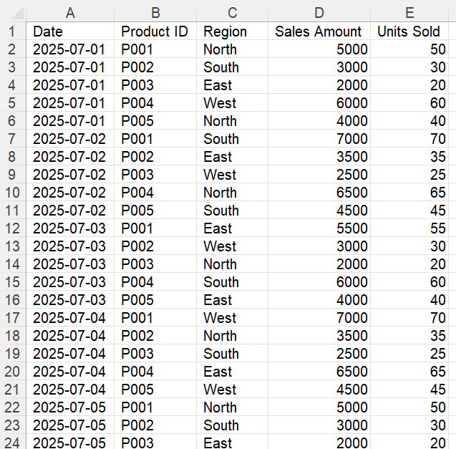
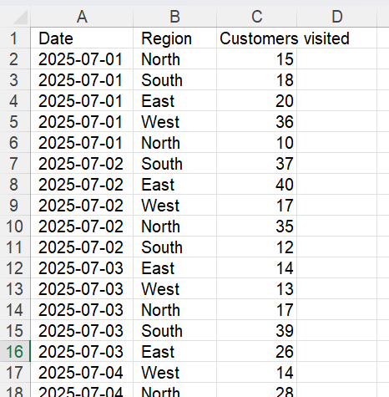
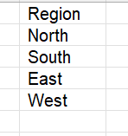
Bridge Data Table
A)
Bridge Data
B)

Slide 8
Additional Considerations
Cross-filter Direction: Power BI allows you to set the cross-filter direction (single or both) to control how filters propagate across relationships. Typically, single-direction filtering is used to ensure performance, while both-direction filtering can be used for complex models where filters need to propagate both ways.
Active vs. Inactive Relationships: Power BI allows you to have multiple relationships between tables, but only one can be active at a time. Use inactive relationships for scenarios where you need to switch context using DAX functions like USERELATIONSHIP.

